Slide 1
Color Image Processing
Color Fundamentals:-
The human visual system can distinguish hundreds of thousands of different shades and intensity , but only around 100 shades of gray. Therefor , in an image , a great deal of extra information may be contained in the color , and this extra information can then be used to simplify image analysis . For example :- object identification and extraction based on color .
When color is available , it give much more information about an image then intensity alone.
Color is very useful for recognition of object in an image both for humans and computer

Slide 2
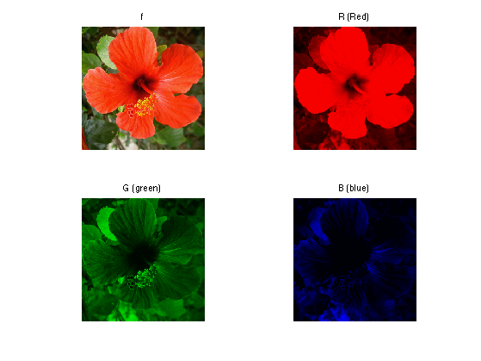

Slide 3
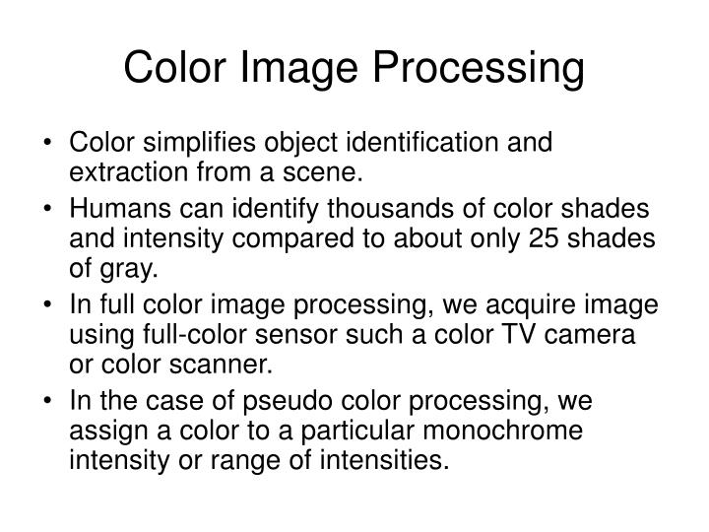

Slide 4
Full-Color Image Processing
Also Called a true-color Image.
True-color Image means the color of an object in an image apper to a human observer the same way as if this observr were to directly view the object .A green tree appears green in the image , A res apple red.
Flase-color image:- the detection of feature that are not readily discernible. For example :-satellite image

Slide 5
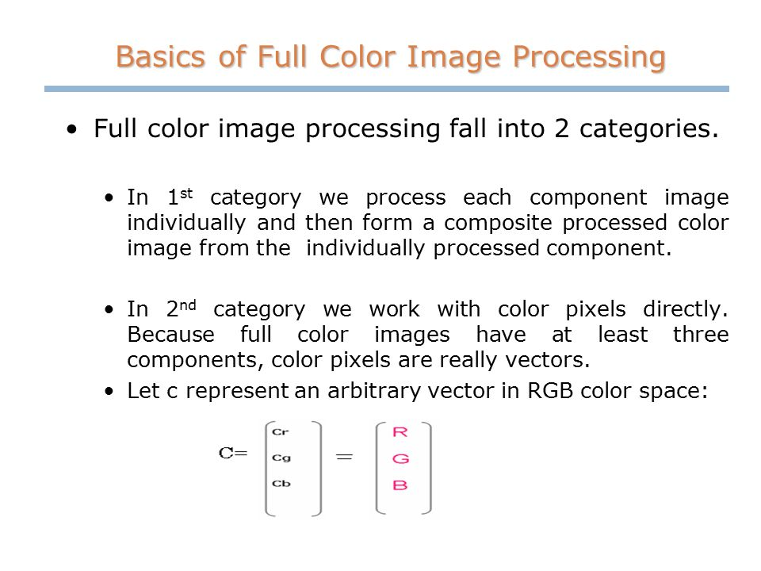

Slide 6
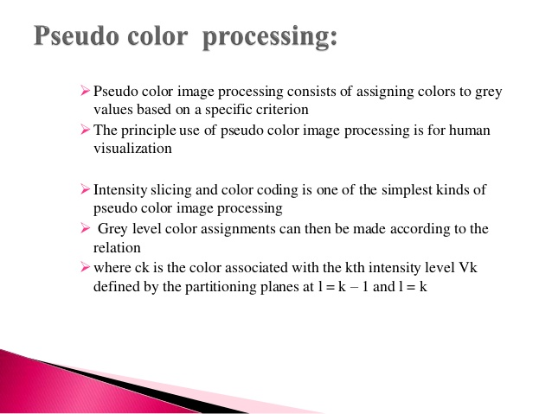

Slide 7
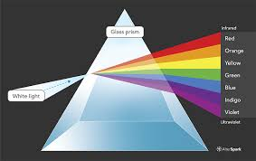

Slide 8

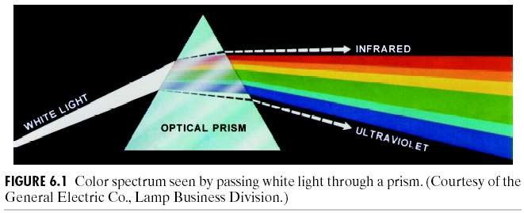
Spectrum of White Light
1666 Sir Isaac Newton, 24 year old, discovered white light spectrum.
(Images from Rafael C. Gonzalez and Richard E. Wood, Digital Image Processing, 2nd Edition.

Slide 9
How do we perceive color?
We see an object because light falls on the object or the object is illuminated by certain source of light , the light gets reflected from the object , it reaches our eye , then only we can see the object.
Similarly , we can perceive the color depending upon the nature of the light which is reflected by the object surface.
The nature of light through the specturm in the visible range gives different color so we can are able to observe it.
The actual color perceived by a human of an object depends on both the color of the illumination and the reflectivity of the object , as well as the sensitivity of human perception.
Gray object or gray image reflect and absorb all frequencies of light about equally , so they do not appear colored.

Slide 10

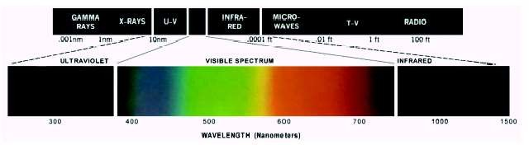

Slide 11
Quality of light
Radiance:-Radiance is the total amount of energy which comes out of a light source and is measured in the form of in units of watts.
Luminance :-Luminance , it is the amount of energy that is perceived by an observer.
Brightness:-it is actually a subjective measure and it is practically not possible to measure the amount of brightness.

Slide 12
If the light is achromatic (void of color), its only attribute is its intensity, or amount
Chromatic light spans EM from 380 to 780 nm
Three basic quantities to describe the quality:
1) Radiance is the total amount of energy that flows from the light source, and it is usually measured in watts (W)
2) Luminance, measured in lumens (lm), gives a measure of the amount of energy an observer perceives from a light source
For example, light emitted from a source operating in the far infrared region of the spectrum could have significant energy (radiance), but an observer would hardly perceive it; its luminance would be almost zero

Slide 13
3) Brightness is a subjective descriptor that is practically impossible to measure. It embodies the achromatic notion of intensity and is one of the key factors in describing color sensation

Slide 14
Primary Colors
Color is sensed by the eye using three kinds of cones cells, each sensitive primarily to red , greem or blue, though there is significant overlap.
We refer to red , green , and blue as the primary colors , and denote to set as RGB.
red=700nm.
Green=546.1nm
Blue=435.8nm

Slide 15
Color Fundamentals
Approximately 65% of all cones are sensitive to red light, 33% are sensitive to green light, and only about 2% are sensitive to blue (but the blue cones are the most sensitive)
According to CIE (International Commission on Illumination) wavelengths of blue = 435.8 nm, green =
546.1 nm, and red = 700 nm

Slide 16
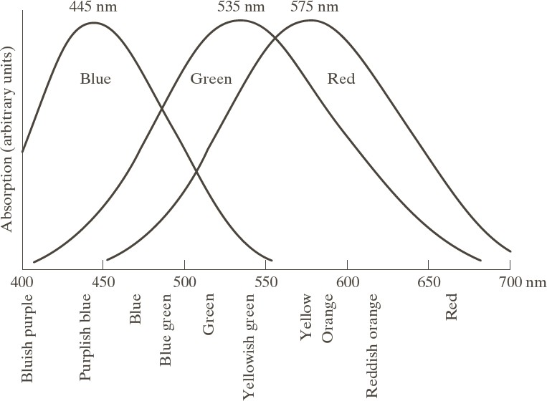
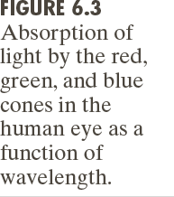
Color Fundamentals
Cones are the sensors in the eye responsible for color vision. 6 to 7 million cones in the human eye can be divided into three principle categories: red, green, and blue

Slide 17
Color Fundamentals
If the light is achromatic (void of color), its only attribute is its intensity, or amount
Chromatic light spans EM from 380 to 780 nm
Three basic quantities to describe the quality:
1) Radiance is the total amount of energy that flows from the light source, and it is usually measured in watts (W)
2) Luminance, measured in lumens (lm), gives a measure of the amount of energy an observer perceives from a light source
For example, light emitted from a source operating in the far infrared region of the spectrum could have significant energy (radiance), but an observer would hardly perceive it; its luminance would be almost zero

Slide 18
Color Fundamentals
If the light is achromatic (void of color), its only attribute is its intensity, or amount
Chromatic light spans EM from 380 to 780 nm
Three basic quantities to describe the quality:
1) Radiance is the total amount of energy that flows from the light source, and it is usually measured in watts (W)
2) Luminance, measured in lumens (lm), gives a measure of the amount of energy an observer perceives from a light source
For example, light emitted from a source operating in the far infrared region of the spectrum could have significant energy (radiance), but an observer would hardly perceive it; its luminance would be almost zero

Slide 19
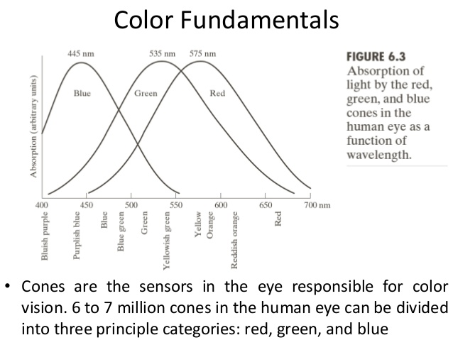

Slide 20
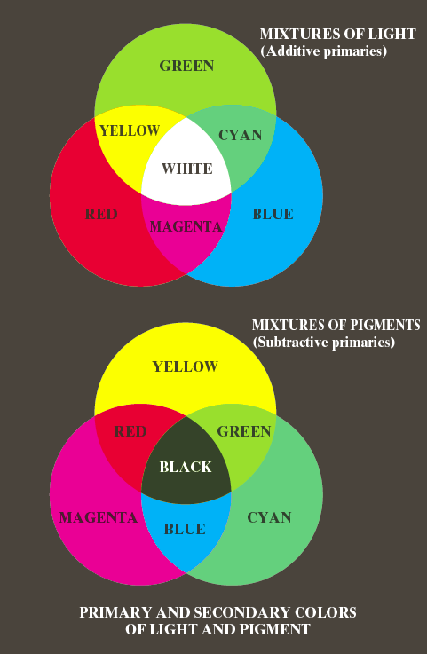
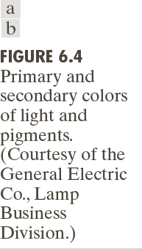
Color Fundamentals

Slide 21
Color Fundamentals
To distinguish one color from another are brightness, hue,
and saturation
Brightness embodies the achromatic notion of intensity
Hue is an attribute associated with the dominant wavelength in a mixture of light waves. Hue represents dominant color as perceived by an observer. Thus, when we call an object red, orange, or yellow, we are referring to its hue
Saturation refers to the relative purity or the amount of white light mixed with a hue. The pure spectrum colors are fully saturated. Colors such as pink and lavender are less saturated, with the degree of saturation being inversely proportional to the amount of white light added

